Slide 1
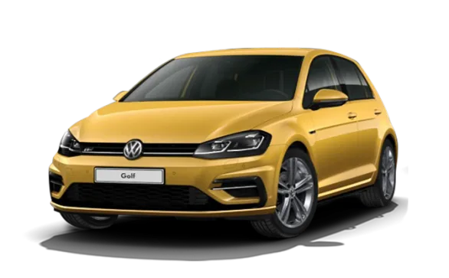
German Car Sales
CODE1161 2020 T2- Ben Dorethy
Open Data Project
Jake Simiana (z5160221)

Slide 2
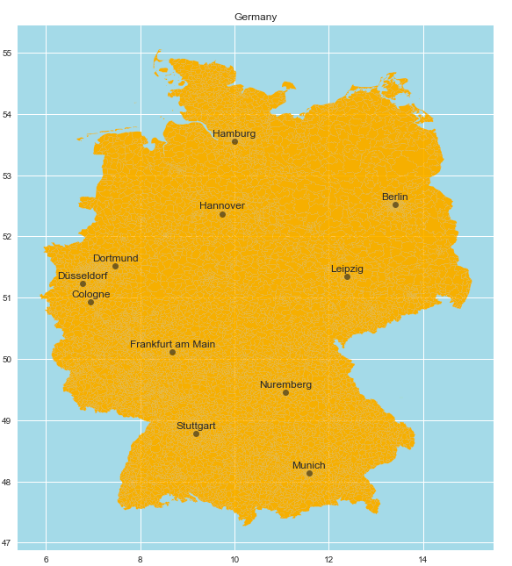


About the data set
This data was web scraped off ebay in 2016 for a couple of months
This dataset was in german, the columns were roughly translated (has around 370 000 entries)
The car data was found on Kaggle
https://www.kaggle.com/orgesleka/used-cars-database

Slide 3
Column Explainations
dateCrawled : when advert was first crawled, all field-values are taken from this date \n
name : headline, which the owner of the car gave to the advert \n
seller : 'privat'(ger)/'private'(en) or 'gewerblich'(ger)/'dealer'(en) \n
offerType : 'Angebot'(ger)/'offer'(en) or 'Gesuch'(ger)/'request'(en)
price : the price on the advert to sell the car
abtest : ebay-intern variable (argumentation in discussion-section)
vehicleType : one of eight vehicle-categories
yearOfRegistration : at which year the car was first registered
gearbox : 'manuell'(ger)/'manual'(en) or 'automatik'(ger)/'automatic'(en)
powerPS : the power of the car in PS
model : the cars model
kilometer : how many kilometres the car has driven
monthOfRegistration : at which month the car was first registered
fuelType : one of seven fuel-categories
brand : the cars brand
notRepairedDamage : if the car has a damage which is not repaired yet
dateCreated : the date for which the advert at 'ebay Kleinanzeigen' was created
nrOfPictures : number of pictures in the advert
postalCode : where in germany the car is located
lastSeenOnline : when the crawler saw this advert last online

Slide 4
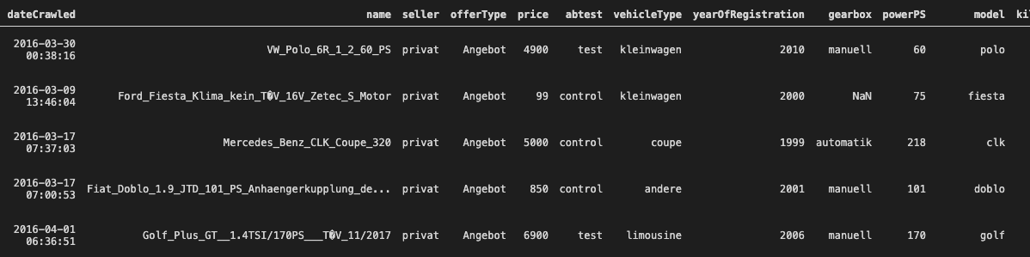
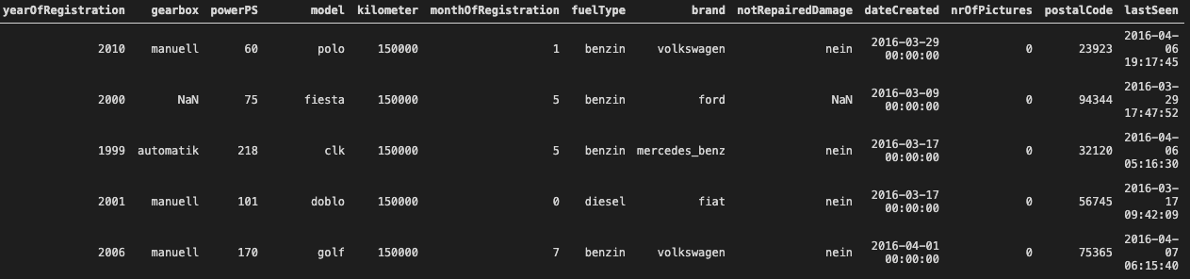
Car Data Columns

Slide 5
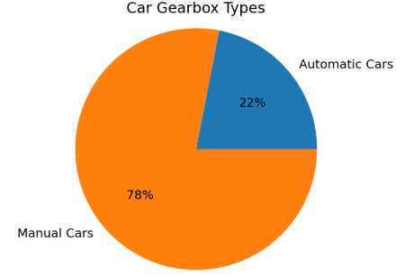
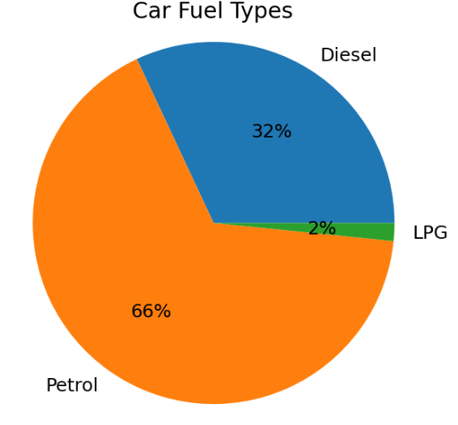
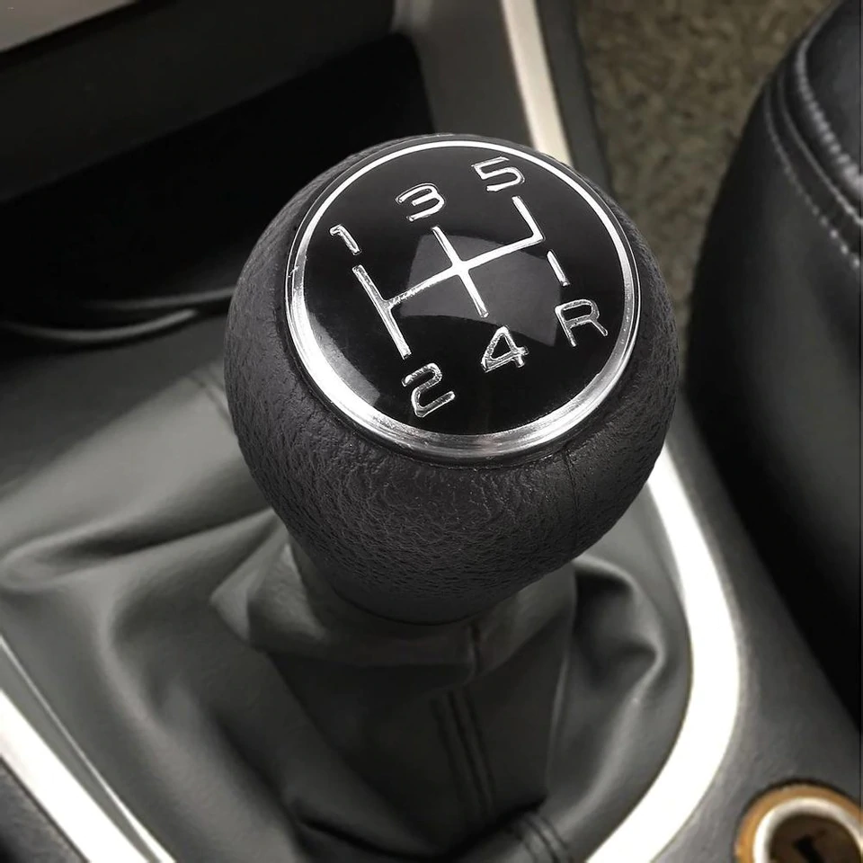
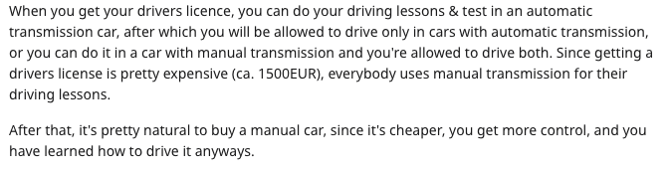
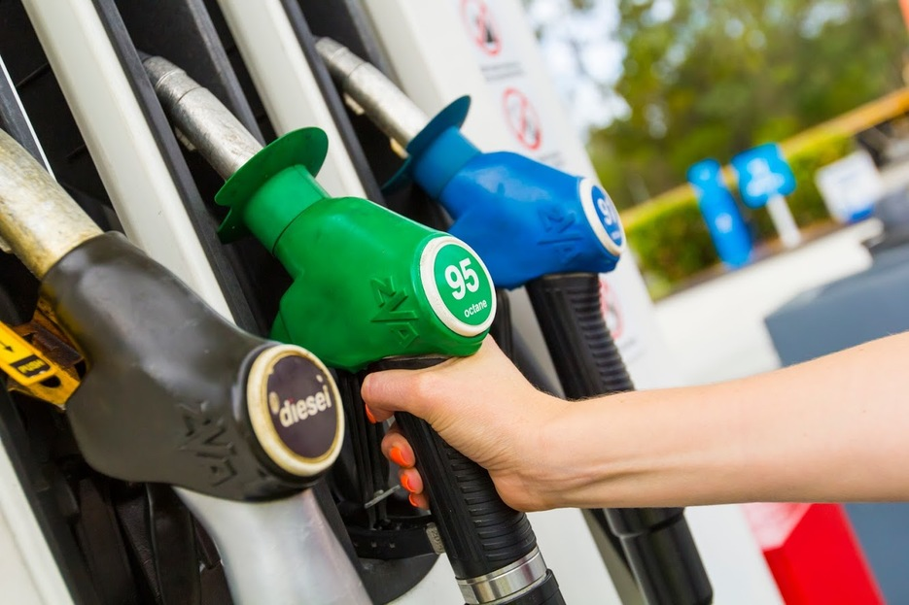
Basic German Car Statistics

Slide 6
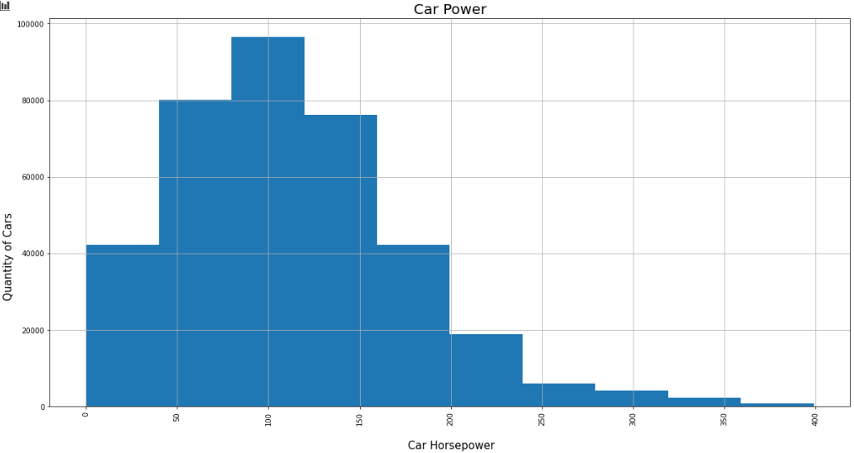
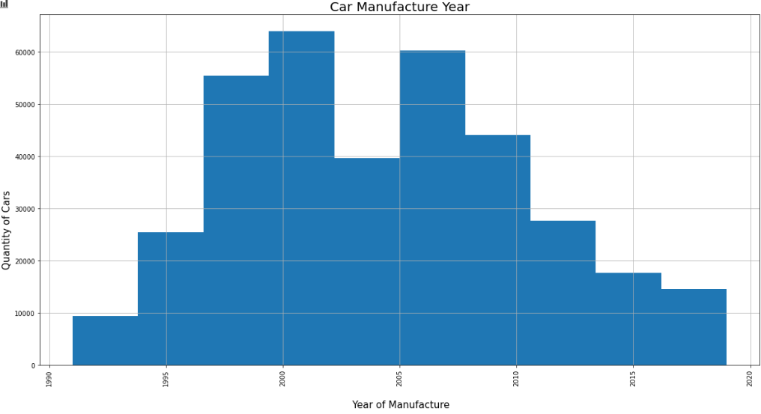
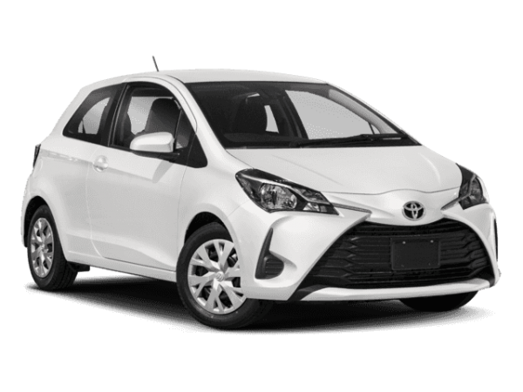
Initial Data speculations
AV Horsepower = 100
Thats equivelant to 1 toyota yaris
AV Horsepower = 100
Thats equivelant to 1 toyota yaris
AV = 100hp
AV = 2004
AV Horsepower = 100
That's equivalent to 1 toyota yaris (106hp)
It looks like people sell cars around the 10 year mark

Slide 7
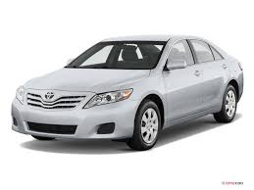
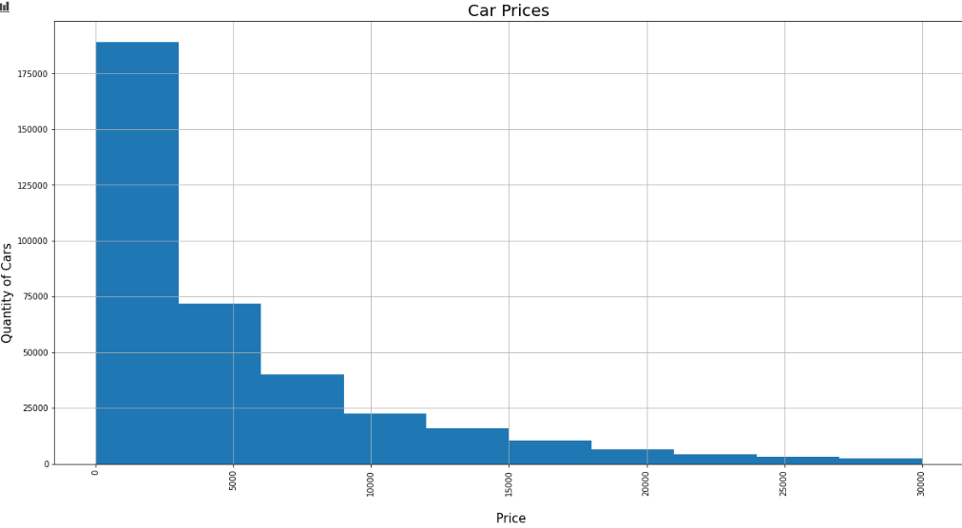

Initial Data speculations
For a 10 year old manual, petrol car with around 100hp
Average Car Price
$4000 euros
= $6000 AUD
Thats Cheap
2010 Toyota Camry
~$10 000 AUD
AV = $4000 euros

Slide 8
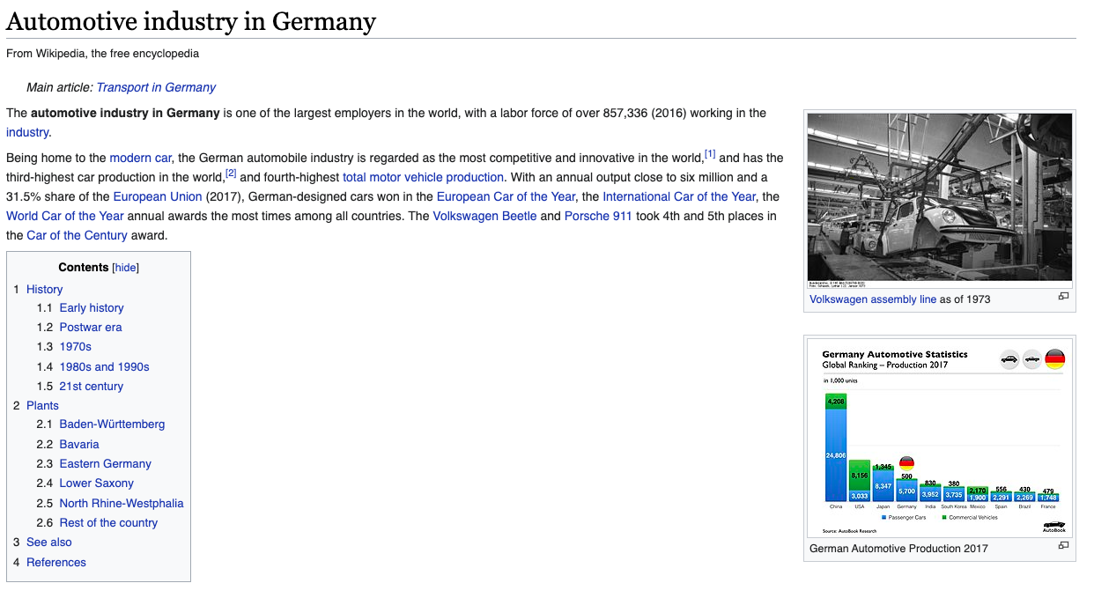

Slide 9
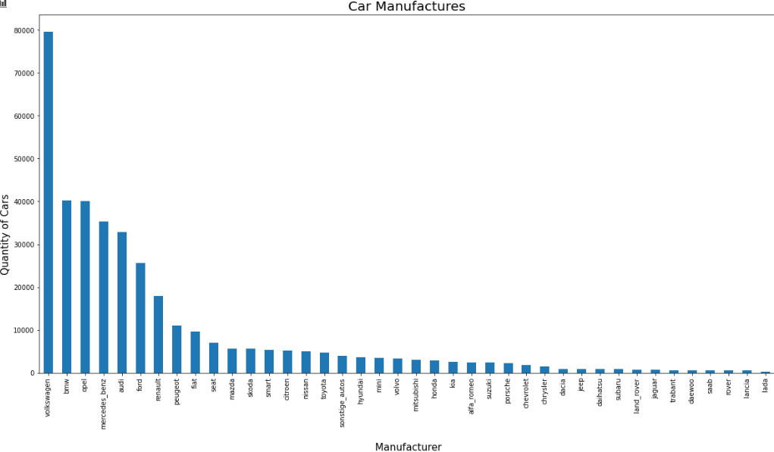
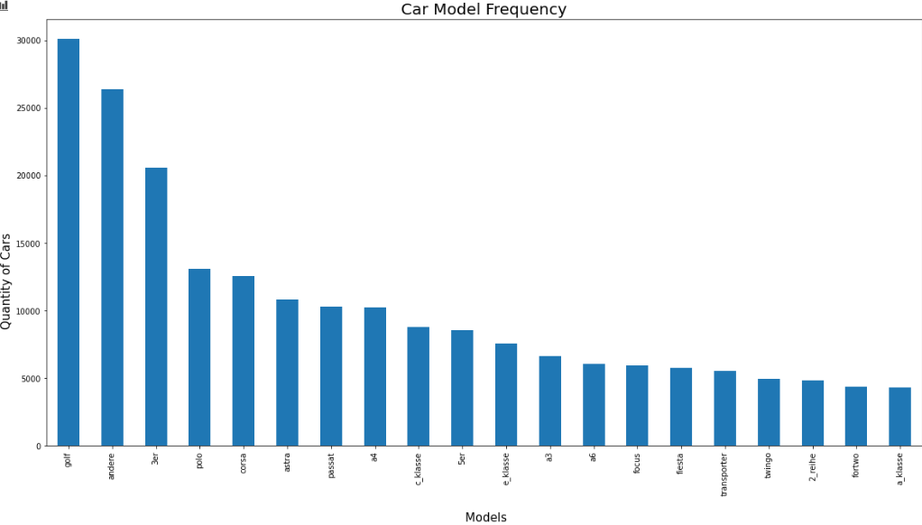
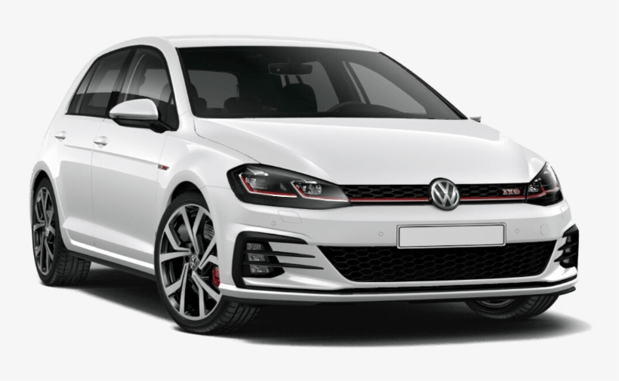
Brand and Model Frequency
Volkswagen Golf
Top Selling car in Germany from (1974-present)
Top Selling car in Europe 2000-2019
Just got overtaken this year by the Renault Clio :(

Slide 10
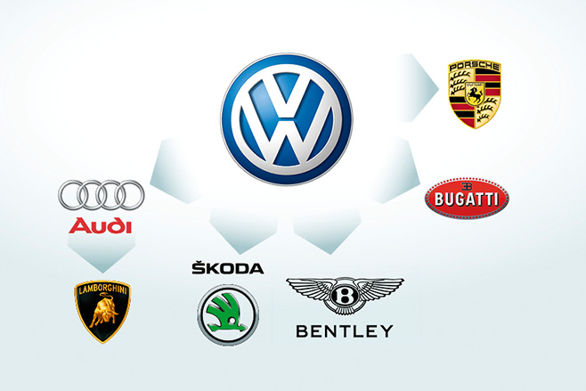
Car Manufactures and Family Companies
From previous slide, there are a couple things obvious
Volkswagen sells a lot of cars
But did you know volkswagen is the parent company for Audi, Bugatti, Skoda, Porsche and even Lamborghini
I researched Parent companies of other car brands

Slide 11
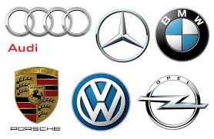
Car Family Companies
toyota : palexus, daihatsu, toyota
general motors : chevrolet, buic, cadillac, holden, hsv
volkswagen : bentley, skoda, audi, lamborghini, bugatti, porshe, volkswagen
fiat chrysler automobiles : jeep, fiat, dodge, abarth, lancia, alpha_romeo, chrysler
psa group : peugeot, citreon, opel, vauxhall
daimler : mercedes_benz, smart, maybach
bmw : bmw, mini, rolls_royce
group renault : nissan, infiniti, mitsubishi, renault
Tata motors : land rover, jaguar
hyundai : hyundai, kia, genesis
geely : volvo, lotus
fuji heavy industries : subaru
independants : everyone else

Slide 12
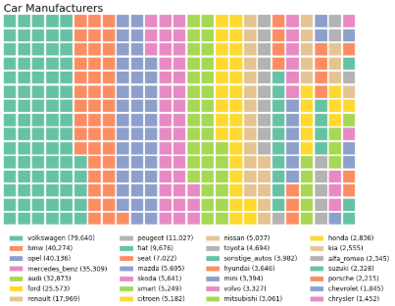
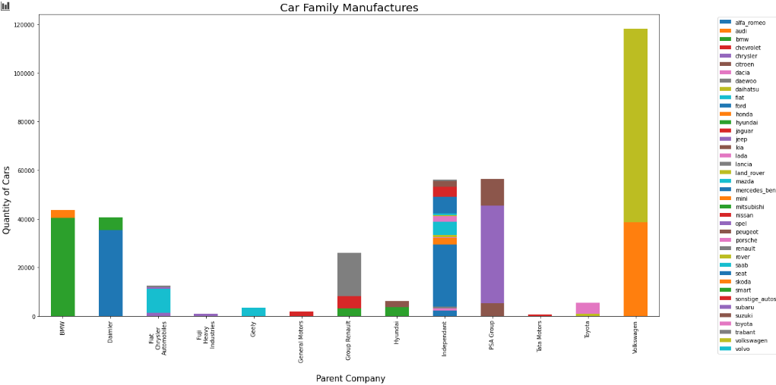
Total Car Sales by Car Brands

Slide 13
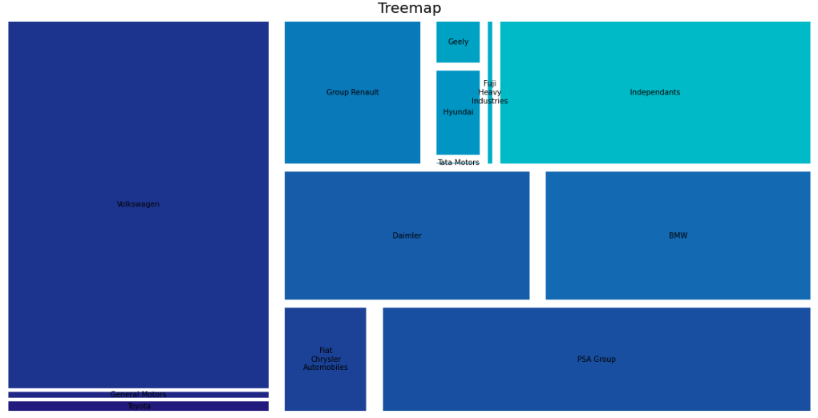
Parent Company Sales

Slide 14
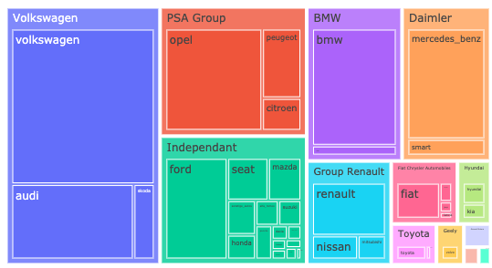
Parent companies

Slide 15
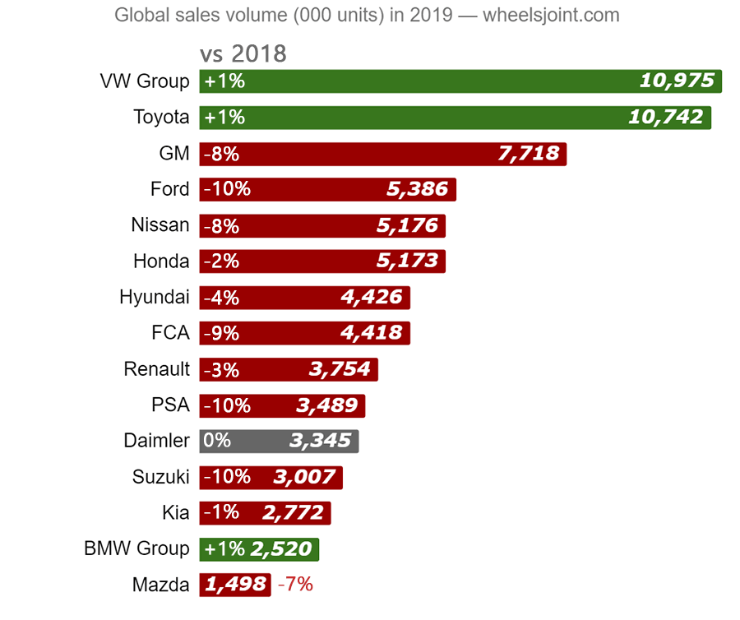
Car Manufactures
Global Car Sale Volume
German Car Sale Volume

Slide 16
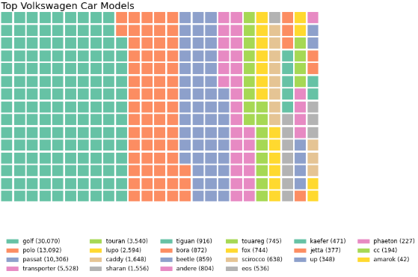
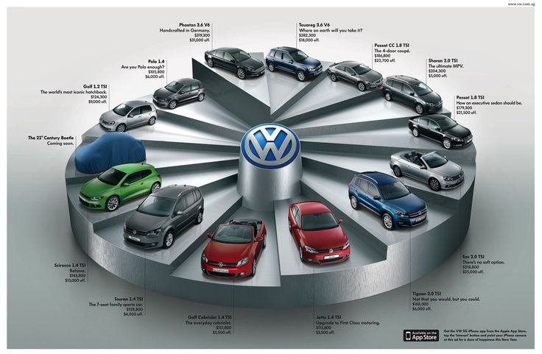
Volkswagen Models

Slide 17
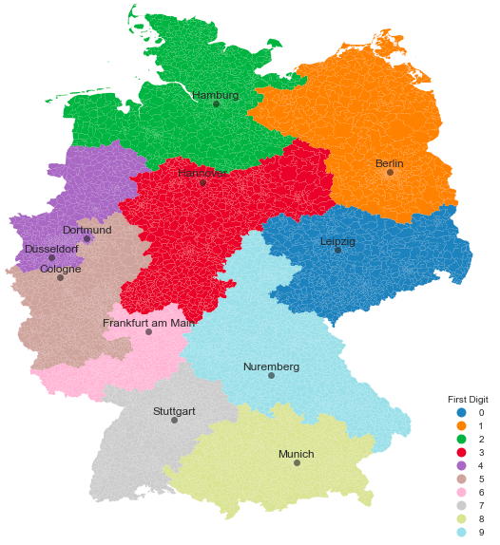
Regional Map Analysis
For these graphs, i used a german shape file found
https://www.suche-postleitzahl.org/downloads
For some reason this dataset excluded Leipzig (0) (seen on the right in dark blue)
Edit=I found out why Leipzig wasnt showing on my charts, and its because the first postalcode digit is a 0

Slide 18
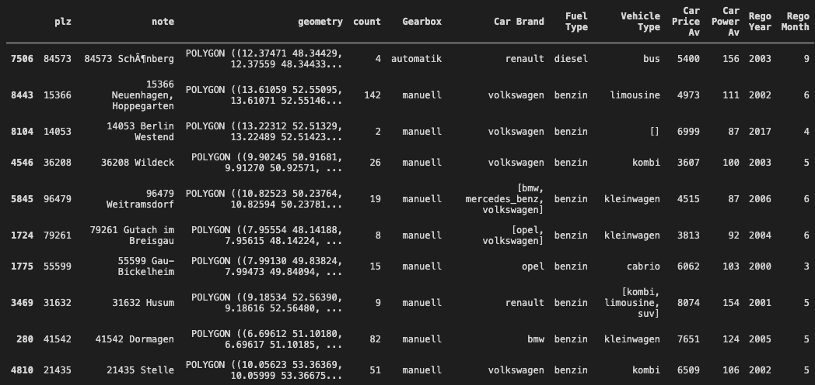
Map Data Columns

Slide 19
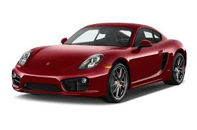
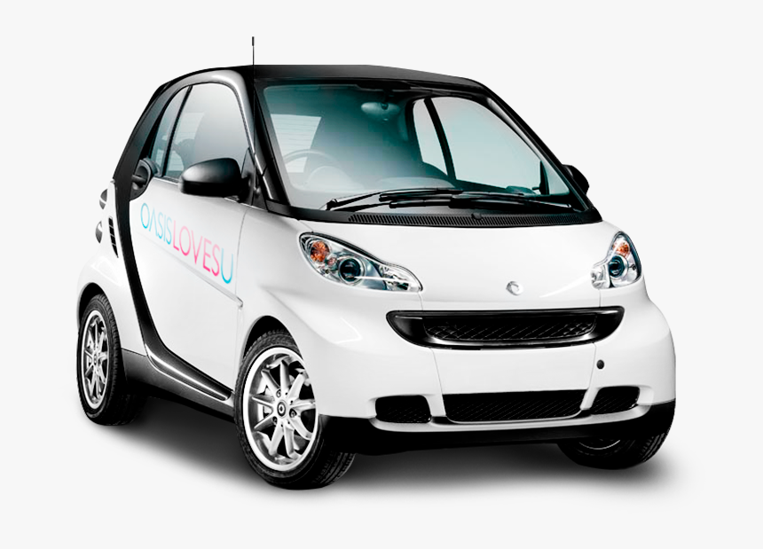
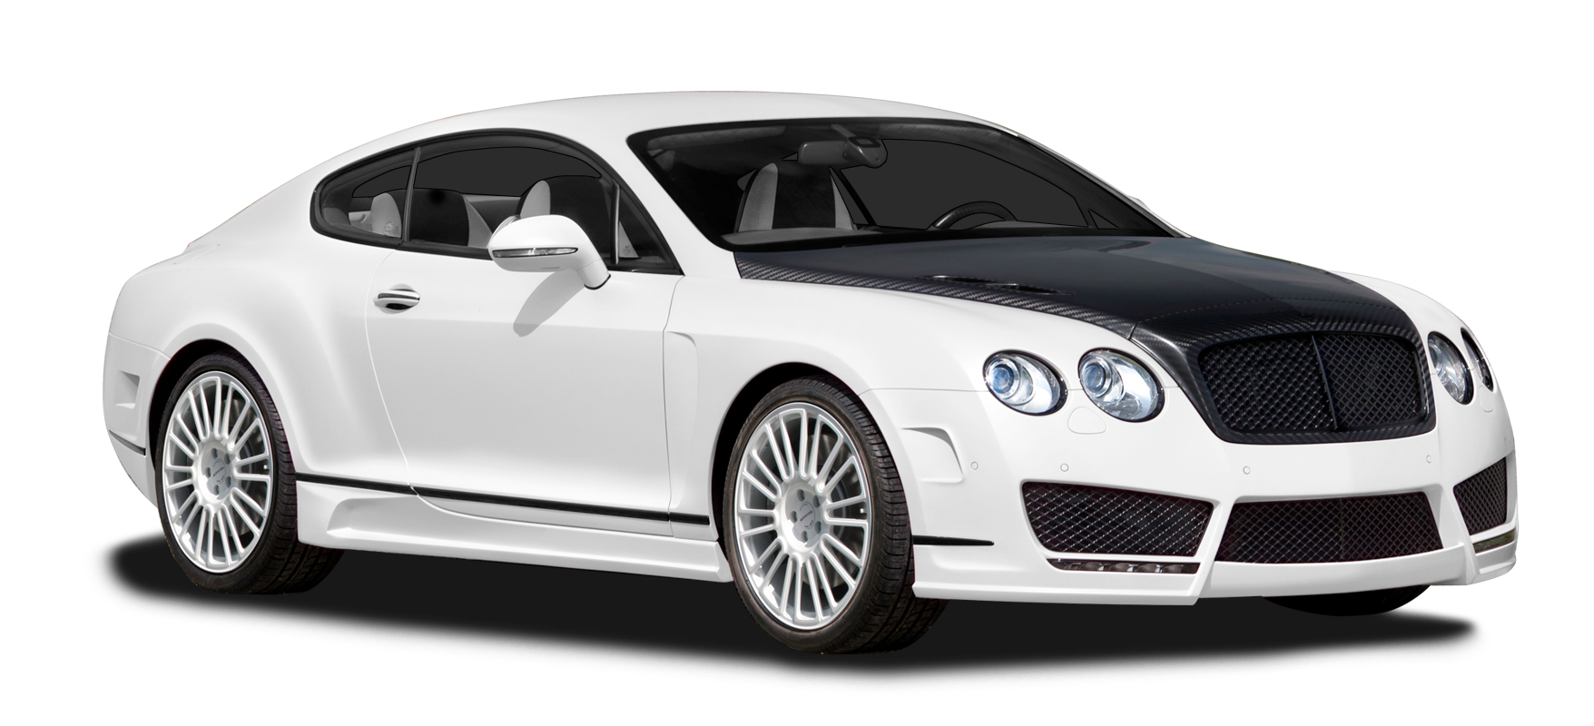
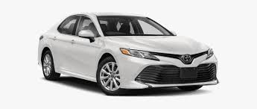
Cool facts i found
I did some searches for some random regional statistics. I used towns with a count of >20 for reliability
Stat | Location | Value | Town Fact
Most Powerful Cars | Sternburg | 849 hp | Sternburg Beer is made there
Least Powerful Cars | DÃsseldorf | 27 hp | One of the wealthiest cities in Germany
Most Expensive Cars | Kaufering, Bavaria | $200000 euros | There’s a famous concentration camp here
Cheapest Cars | Kalbe,Saxony-Anhalt | $1400 euros | Its near Wolfsburg which is the headquarters of Volkswagen and for the Autostadt

Slide 20
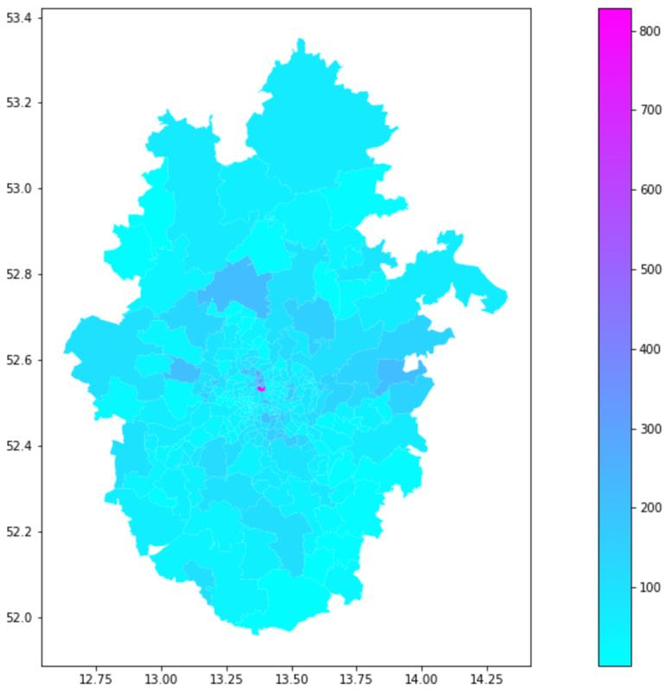
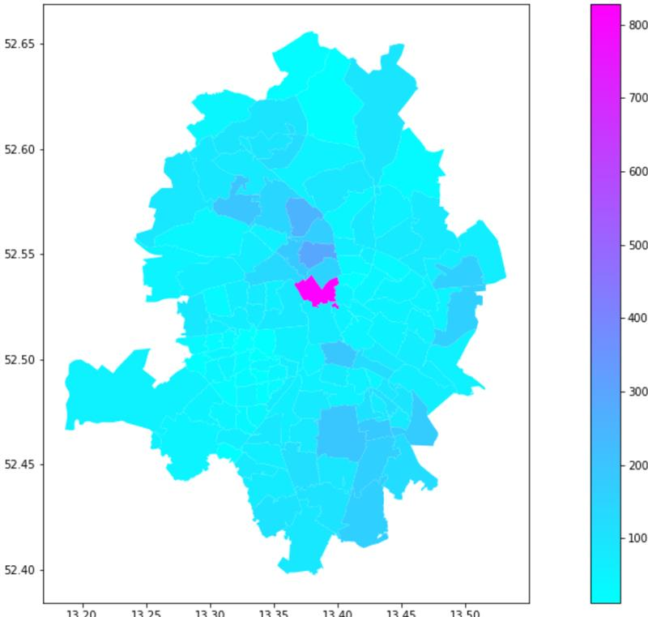
Town with the Top Cars Sales
1km radius Suburbs Surrounding Mitte, Berlin
0.25 km radius Suburbs Surrounding Mitte, Berlin
Car Sales Regional
Car Sales Regional
Cool Fact - Mitte, Berlin has alot of old historical buildings and a place called Museum Island

Slide 21
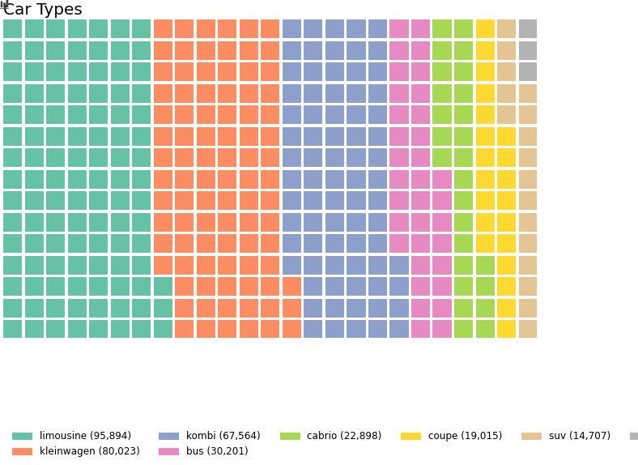
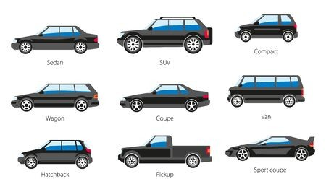
Car Types
German | English
Limousine | Sedan
Kombi | Wagon
Cabrio | Convertible
Keinwagen | Small Car

Slide 22
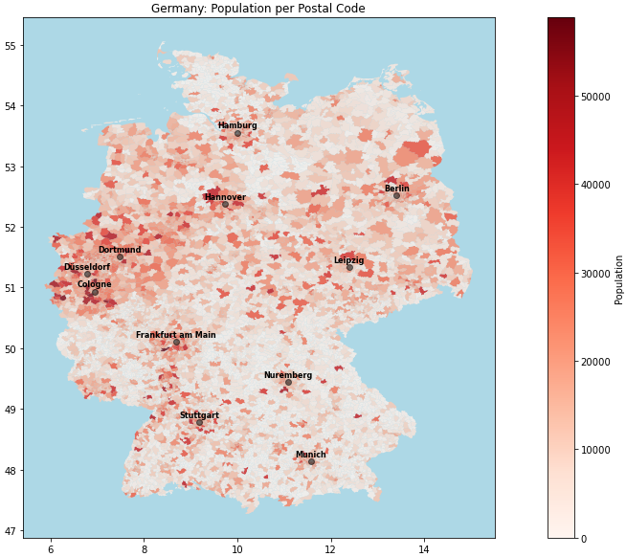
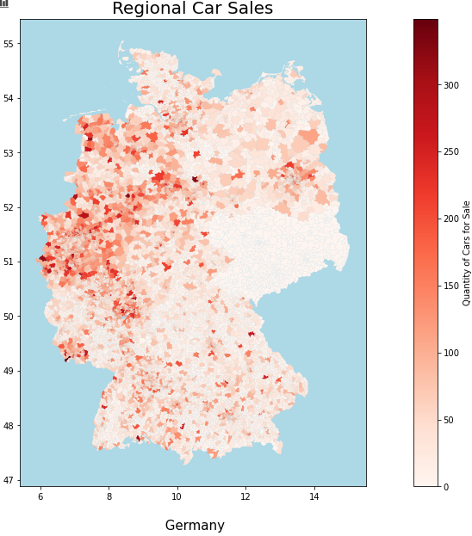

Slide 23
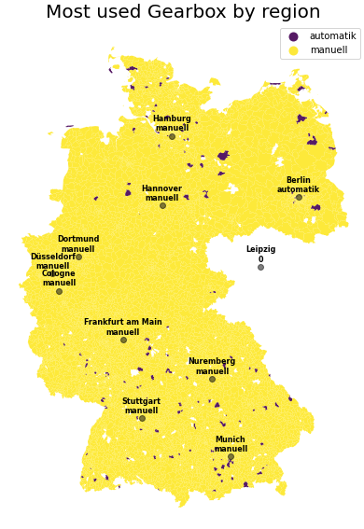
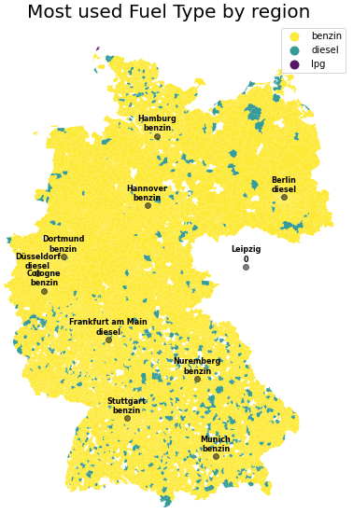

Slide 24
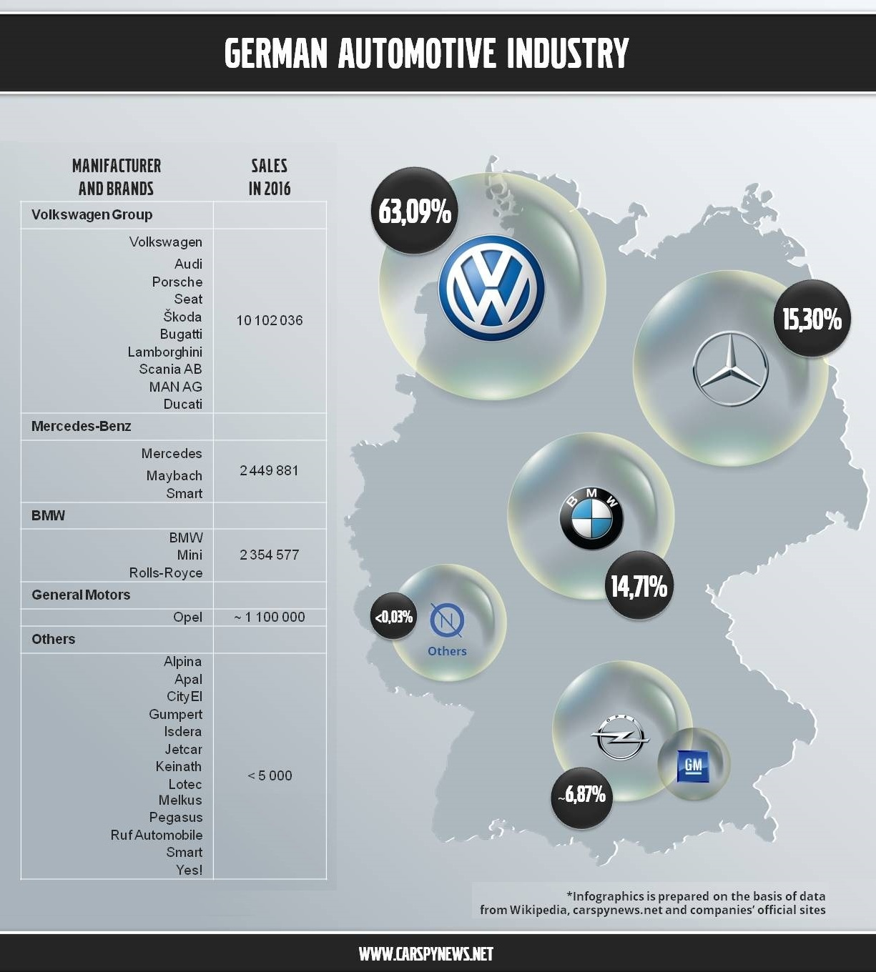
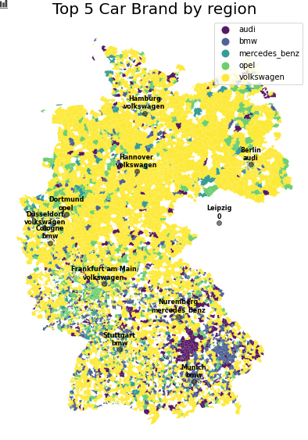

Slide 25
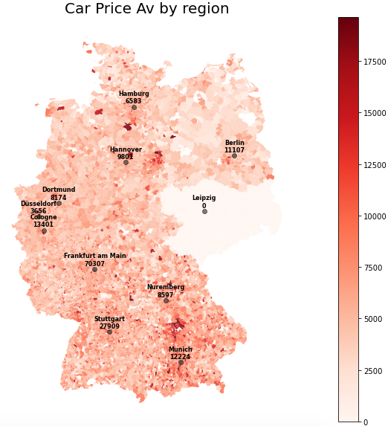
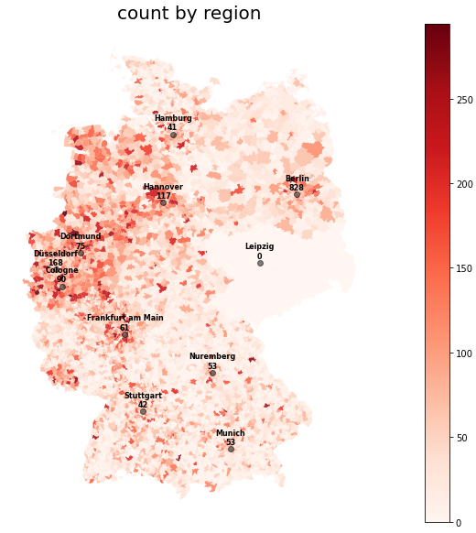
√

Slide 26
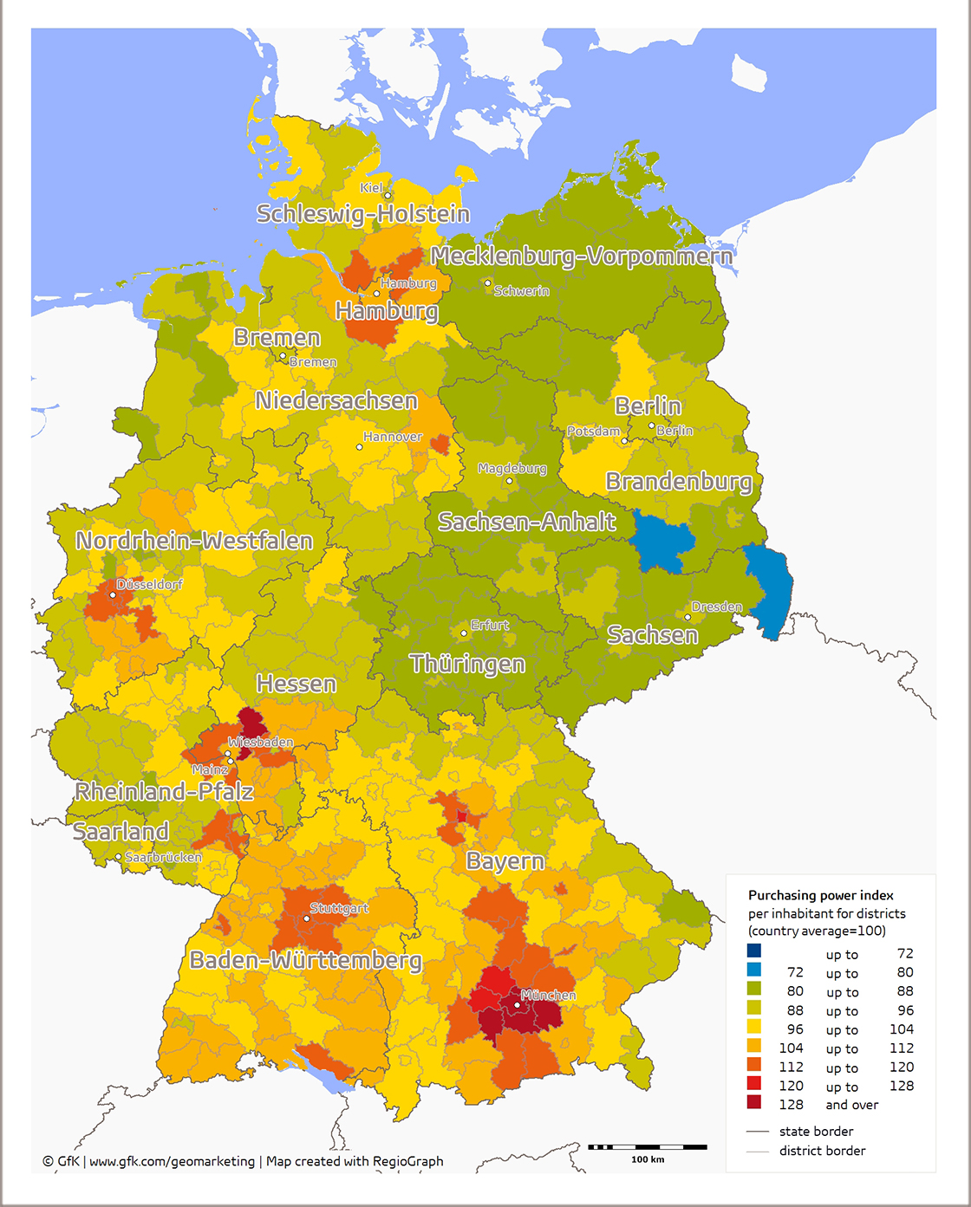
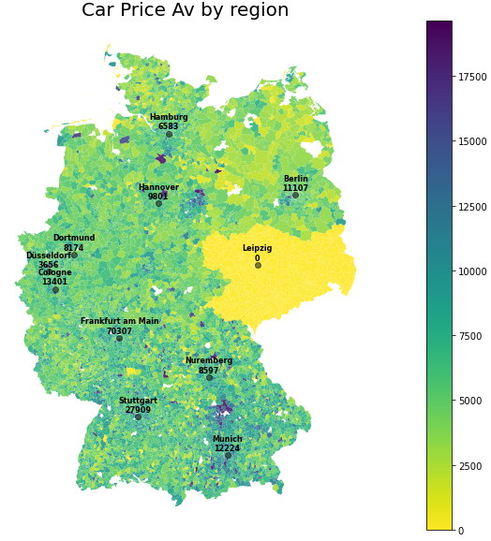
Cost of living Regionally

Slide 27
Final Thoughts
If you live in Germany, there is a high chance you own a 10 year old Volkswagen Golf
There a more cars for sale in higher populated areas (wow), and cars are more expensive in cities with low sales counts (#supply&demand)
If you want a cheap car, buy one from Kalbe, Saxony-Anhalt
Volkswagen sells a lot of cars also owns a lot of car manufacturer companies
There are more cars (and cheaper) in the top left of germany
People in Munich like bmw’s, so they are probably bad drivers

